Slide 1
Compressed Sensing
Agrega conocimiento previo

Slide 2
MRI under-sampling
MR data acquisition
k-space data – trajectories – under-sampling
Information versus data
Data is redundant and carries little information
Image compression concept
Image reconstruction
The recon is an under-determined inverse problem
Compressibility is an excellent prior
Optimization setup

Slide 3
Data versus information
Fourier Domain
Image
Displayed image
Recon
Store
Retrieve
Compressed image
Redundancy
Data
Information

Slide 4
The Compressed Sensing approach
Displayed image
Under-sampled Fourier Domain
Recon
Sparse domain
Data
Information

Slide 5
Image compression
Represents the information (interpretation of the data in a meaningful way)
with the less possible data: reduce data redundancy
Data redundancy | Measure
Code | Entropy
Interpixel and Interframe | Mutual information or correlation
Lossless compression
Typical example: GIF or PNG

Slide 6
Image compression
Represents the information (interpretation of the data in a meaningful way)
with the less possible data: reduce data redundancy
Data redundancy | Measure
Code | Entropy
Interpixel and Interframe | Mutual information or correlation
Psychovisual | Human perception
Lossy compression
Typical examples: JPEG, MPEG

Slide 7
Image compression
Represents the information (interpretation of the data in a meaningful way)
with the less possible data: reduce data redundancy
Data redundancy | Measure | MRI use
Code | Entropy | Not relevant
Interpixel and Interframe | Mutual information or correlation | No need to acquire all the data: below Nyquist rate.
Psychovisual | Human perception | We are willing to loose irrelevant information

Slide 8
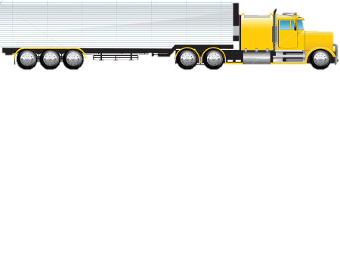

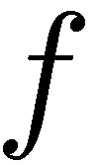
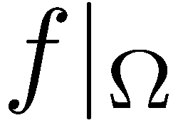
Acquire less
Truncate

Slide 9

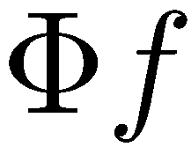
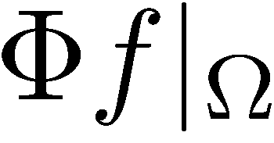
Importance of transformations
Pack the information and then truncate

Slide 10
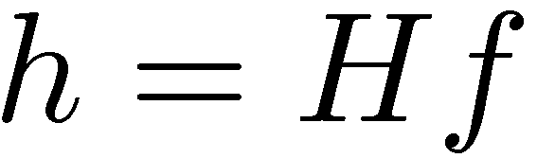
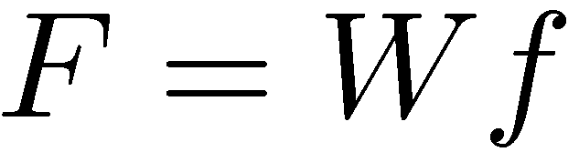
Importance of transformations
Canonical
Walsh-Hadamard
Fourier

Slide 11
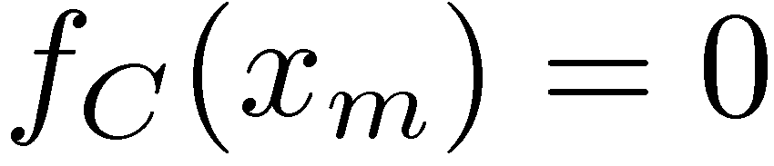
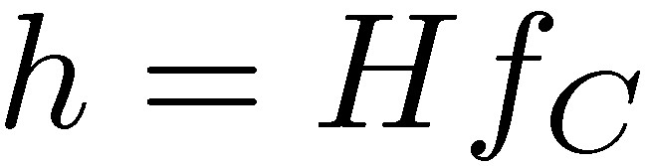
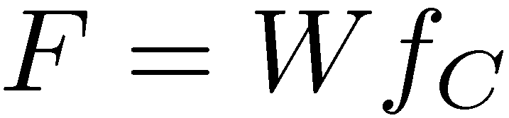
Importance of transformations
Canonical
Walsh-Hadamard
Fourier
25% of the data missing in the canonical domain

Slide 12
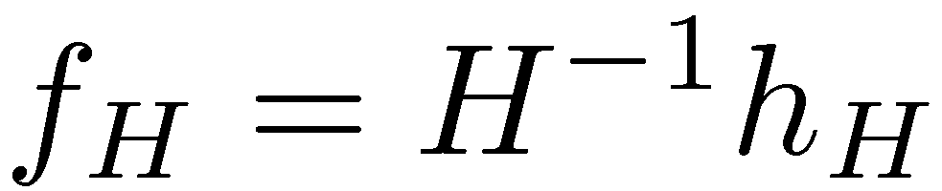
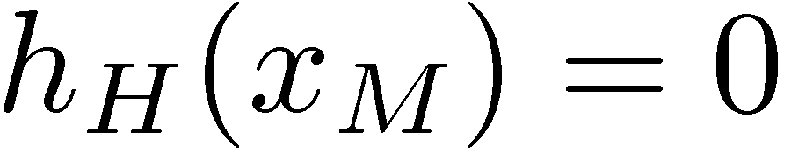
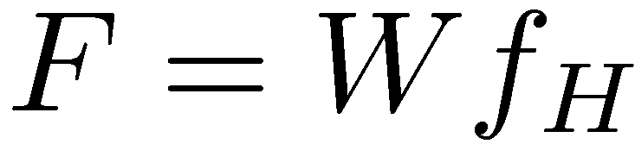
Importance of transformations
Canonical
Walsh-Hadamard
Fourier
25% of the data missing in the Walsh-Hadamard domain

Slide 13
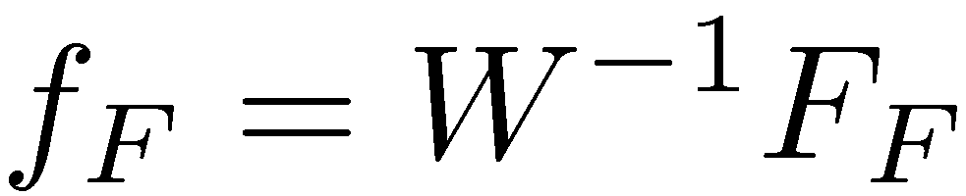
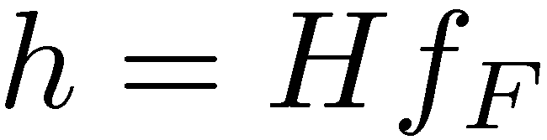
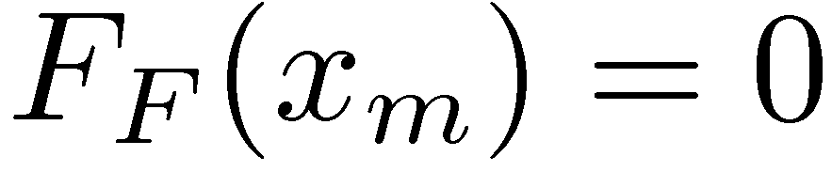
Importance of transformations
Canonical
Walsh-Hadamard
Fourier
25% of the data missing in the Fourier domain

Slide 14
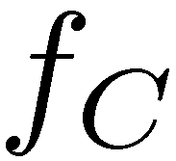
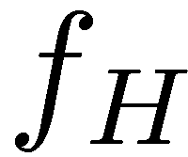
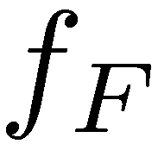
Importance of transformations
Canonical
Walsh-Hadamard
Fourier
In this example, the Fourier transform has the best packing property (25% of data missing).

Slide 15
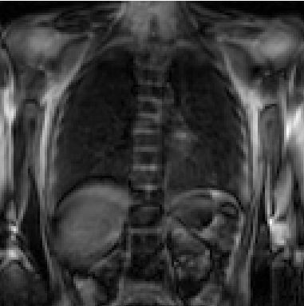
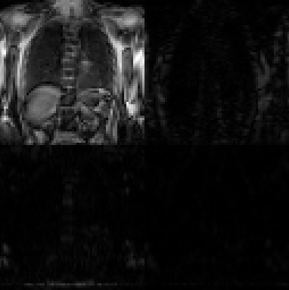
Example from the lung
One slice from the lungs
2D Wavelet transformation

Slide 16
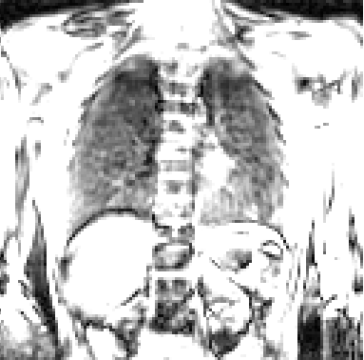
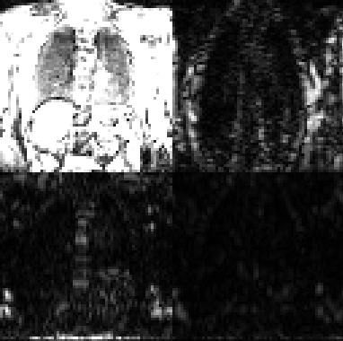
Example from the lung
One slice from the lungs
2D Wavelet transformation
Windowed to 20%

Slide 17
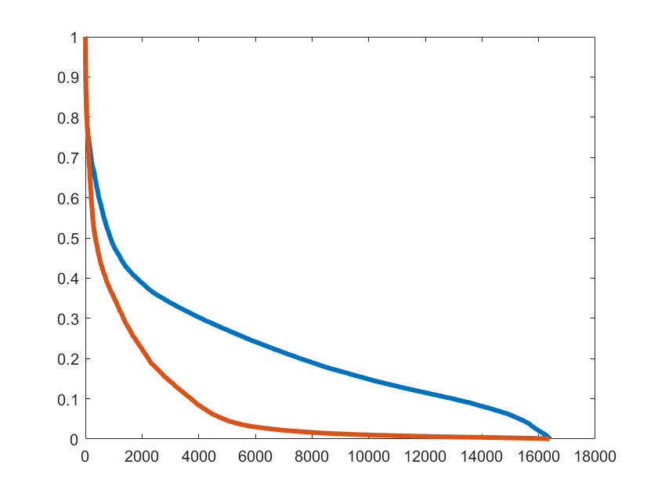
Example from the lung
Original image
Wavelet
Ordered pixel values

Slide 18
MRI under-sampling
MR data acquisition
k-space data – trajectories – under-sampling
Information versus data
Data is redundant and carries little information
Image compression concept
Image reconstruction
The recon is an under-determined inverse problem
Compressibility is an excellent prior
Optimization setup

Slide 19
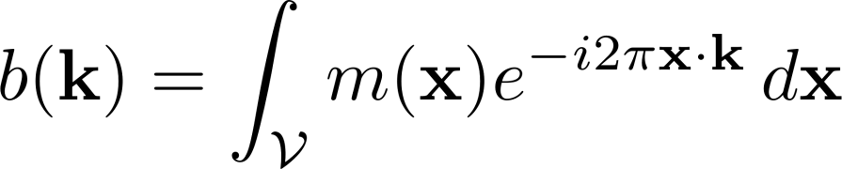


Image Reconstruction
Acquired data (fully sampled)
N unknowns and N equations
Reconstruction
Inverse FFT

Slide 20



Image Reconstruction
Acquired data (n under-sampled)
N unknowns and n equations
Reconstruction
does not exist infinite solutions
What can we do?

Slide 21
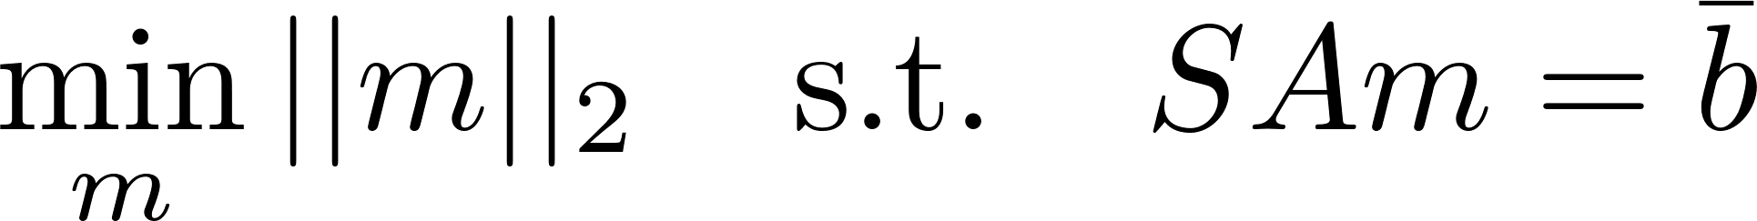
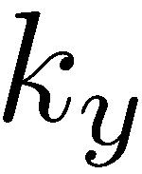
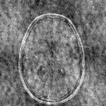
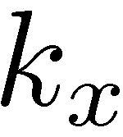
What can we do?
From all infinite images choose the one that
has the minimum energy
Zero filling

Slide 22



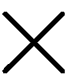

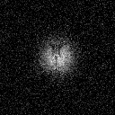
What can we do?
From all possible images choose the one that
has the smallest FOV
Interpolation

Slide 23

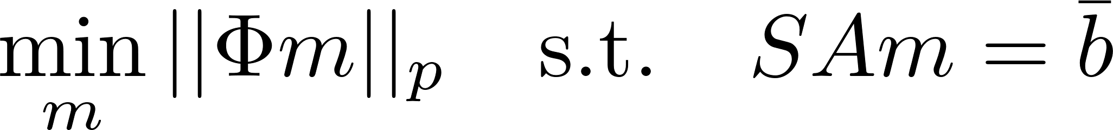

What can we do?
From all possible images choose the one that
it is most compressible in some domain : Compressed Sensing
Now the questions are:
What norm p should we use?
Which sparsifying transform should we use?
Which under-sampling rate should we use?
What optimization formulation/algorithm should we use?

Slide 24
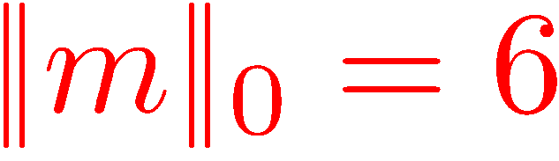
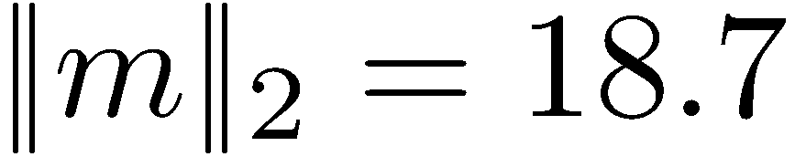
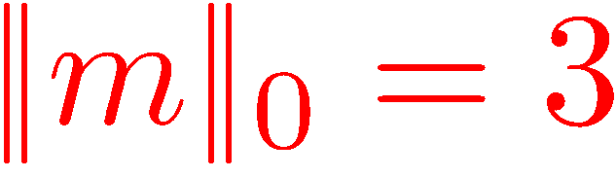
Norms
For compression, ideally, we want p=0 (counting non-zero entries)

Slide 25


Norms
But if we want to end during this lifetime, better use a convex norm
better compressibility (less samples required)
faster convergence

Slide 26
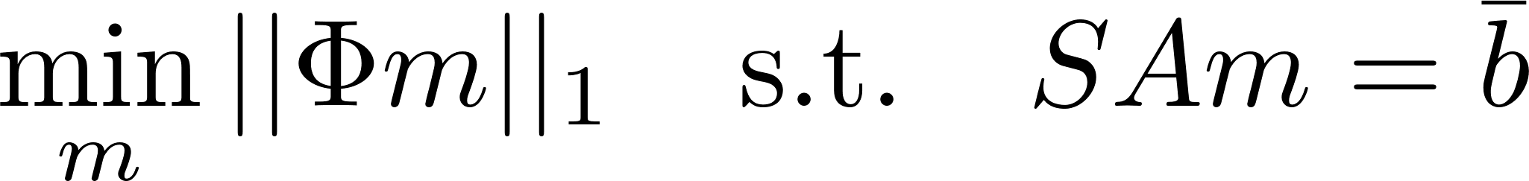
Norms
better compressibility (less samples required)
faster convergence

Slide 27
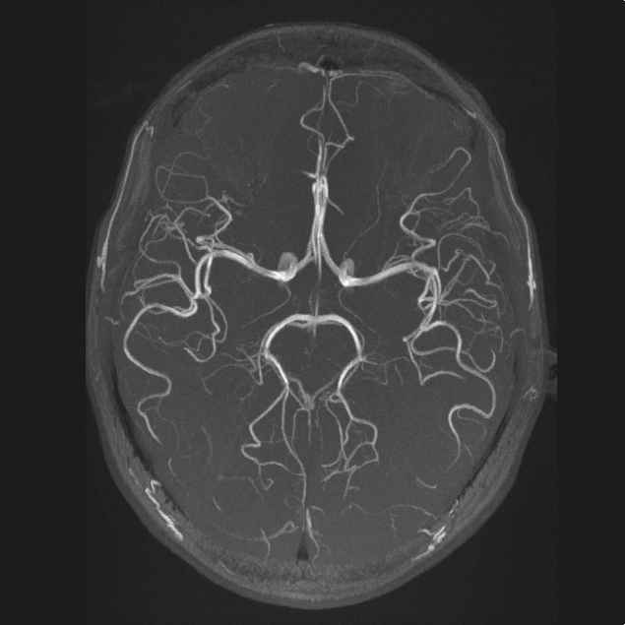
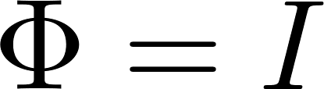

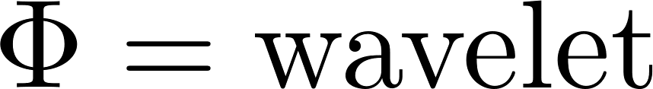

Sparsifying transform
Data dependent
Some images are sparse in the canonical domain, or in the gradient domain
Others may need

Slide 28
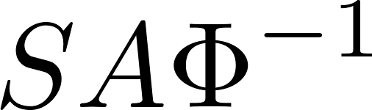
Under-sampling
Sampling matrix must be incoherent with respect to the sparse domain (this is similar to satisfying the RIP property)
Likely to be true if S chosen randomly and is not the Fourier transform!
Always a good idea to keep center of k-space fully sampled

Slide 29
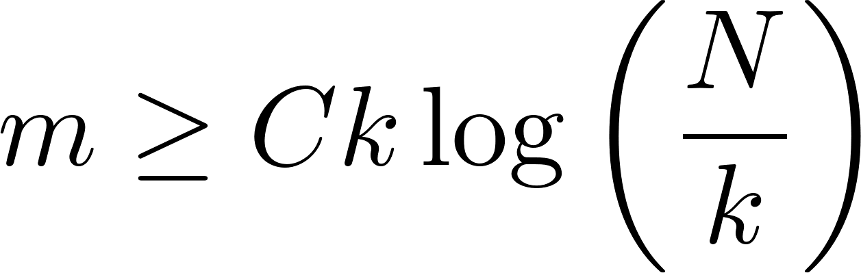
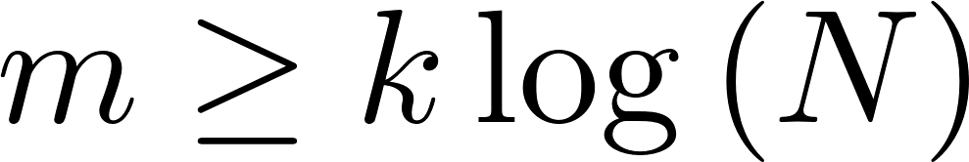
Under-sampling
How many samples?
In practice, more than 2k
Lots of try and error, because we don’t know k
Typical acceleration factors: 4x, 6x, 8x, even 16x
and more versions, depending on size, type of sparsity domain, etc.

Slide 30
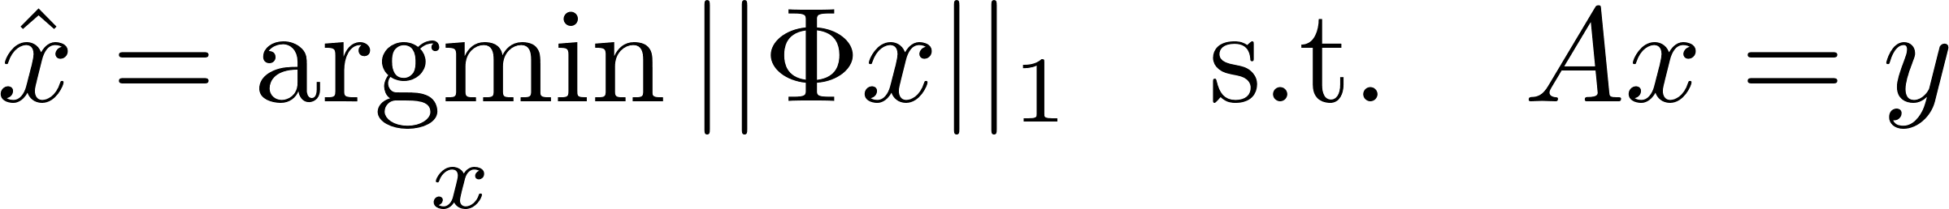
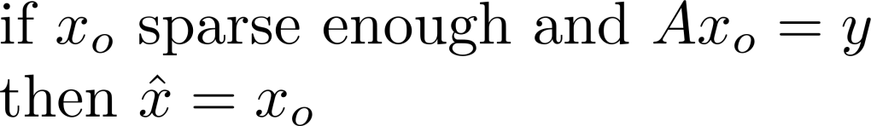
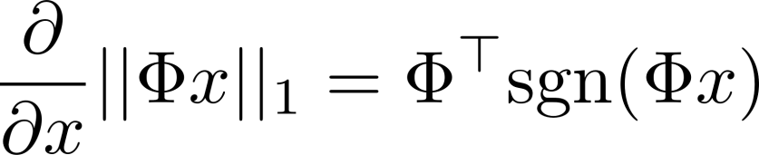


Optimization framework
Basis pursuit (can be recast to LP)
The gradient is needed
and sometimes it is difficult to compute efficiently the transpose.
Obviously and are computed with fast algorithms (FFT for instance)

Slide 31
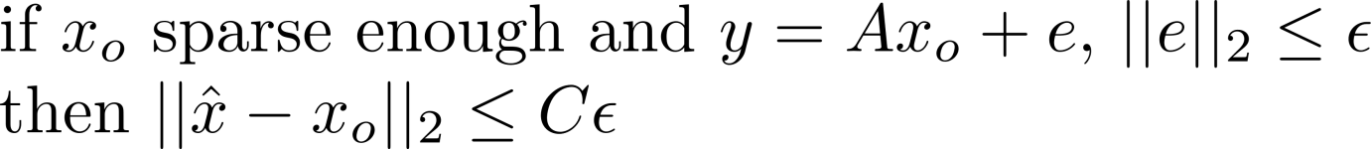
Optimization framework
Basis pursuit with quadratic constraint (can be recast to SOCP)
Naturally allows noise in the measurements.

Slide 32
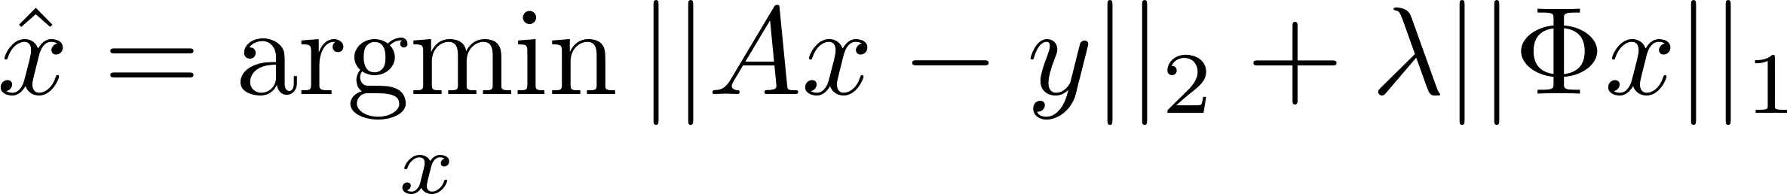
Optimization framework
Unconstrained formulation
Most popular setup, but difficult to tune the Lagrangian multiplier

Slide 33
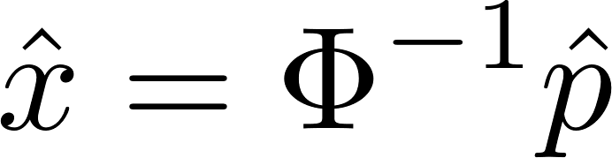
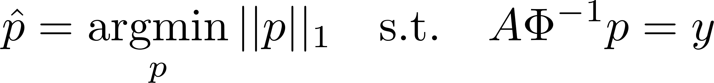
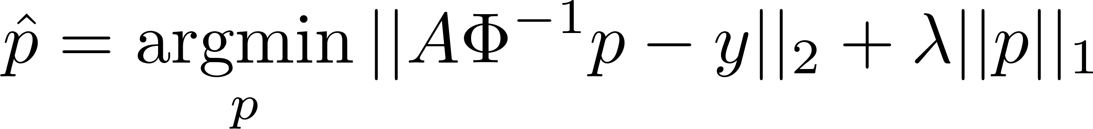
Also possible to formulate in sparse domain
Simplifies gradient computation but less stable

Slide 34
Still more possibilities
This one may be useful if uncertain of sparsity
Starting with large k: keep reducing it while data consistency is possible.
Starting with small k: keep increasing until acceptable data consistency is achieved.

Slide 35

Very nice results for some images
Original
5x faster (20% of the data)

